Slide 1
BESTBUY Inventory Management Assignment
Presentation
Dorothy Zou

Slide 2
Project analysis slide 3
Inventory Management
Models
development
and applications
Business Purpose
Design the solution
Data
understanding
Further
Improvement
Understanding the business requirements, pain points, market background knowledge, desire.
Design the solution and the path of accomplishment to solve this problem
Explore the data and demonstrate data visualization
Design, develop and optimize two models used for solving the issue of this project; describe the applications of the models
Discuss the further enhancement of the base models

Slide 3
Project analysis slide 8
Inventory Management
Business requirements:
Sales forecasts by a model and guide the inventory analysis
to minimize the warehouse space but also satisfy customers’ demand.
Steps:
To minimize the warehouse space, we need to consider whether the current stock is much more than the demand
Assumes all five products (A,B,C,D,E) have the same size, then the problem is how much inventory we need to buy
Inventory is related to customers’ demand, then the problem becomes what customers’ demand is
The solution is to build a forecast model to predict customers’ demand
The following step is to compare the demand and current stock so we can decide the inventory amount

Slide 4
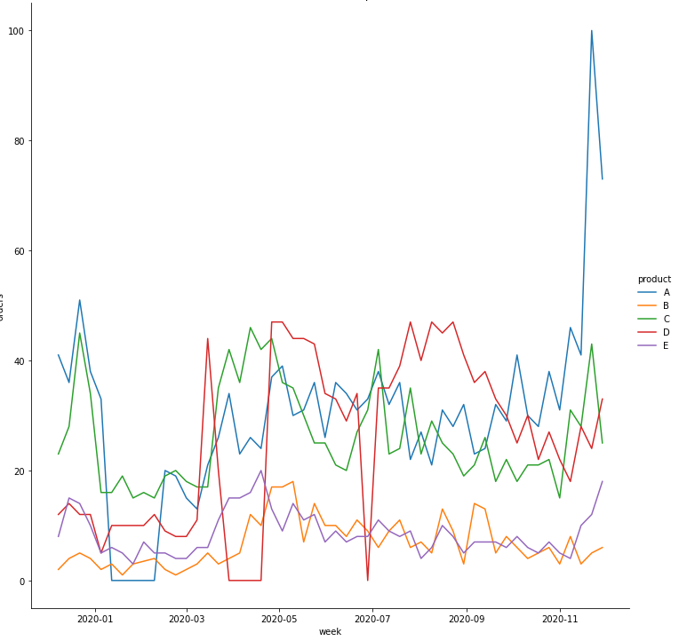
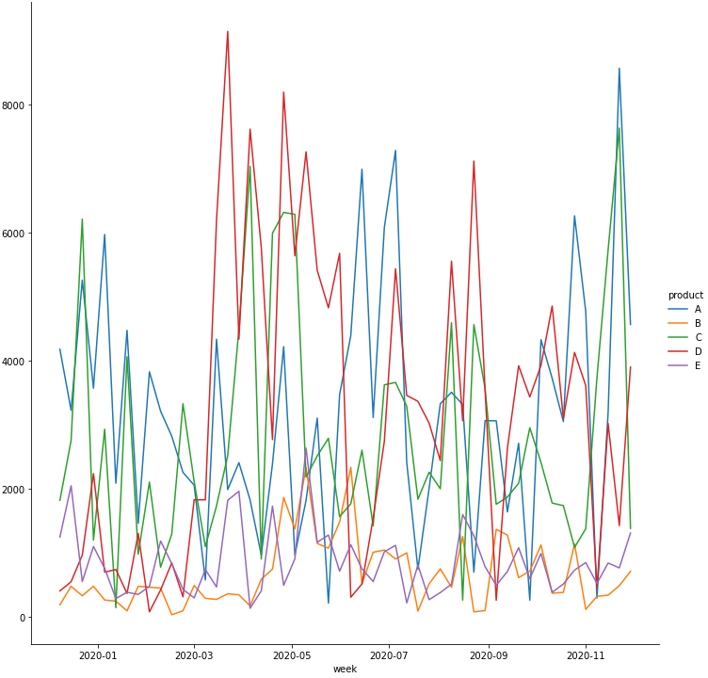
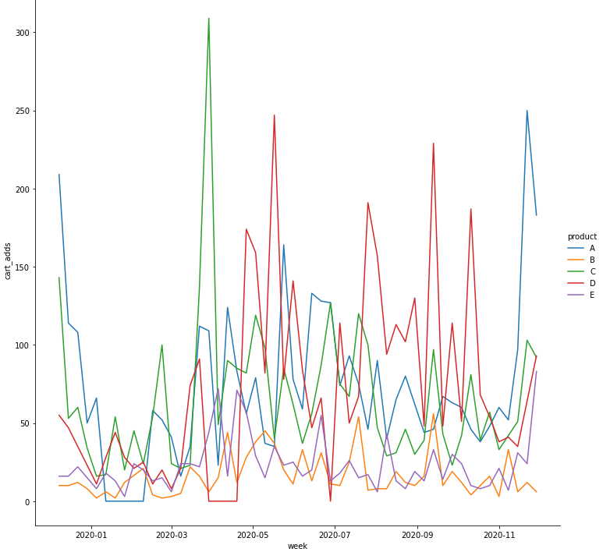
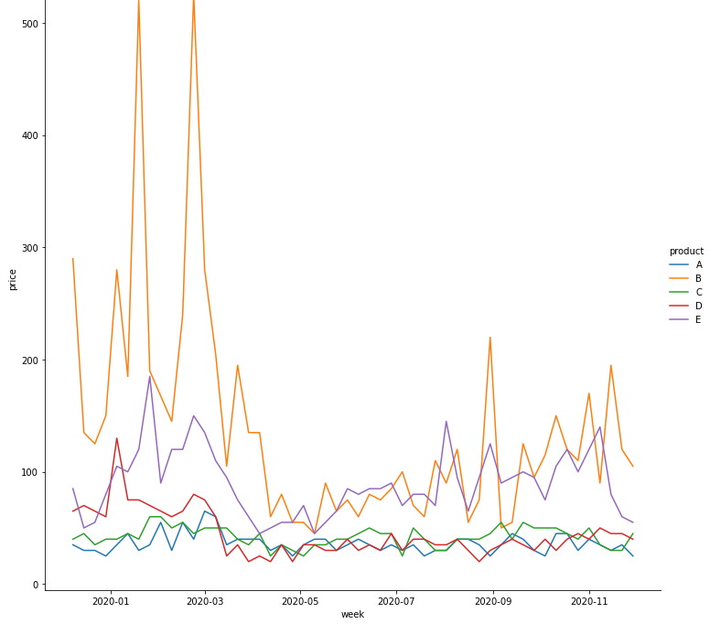
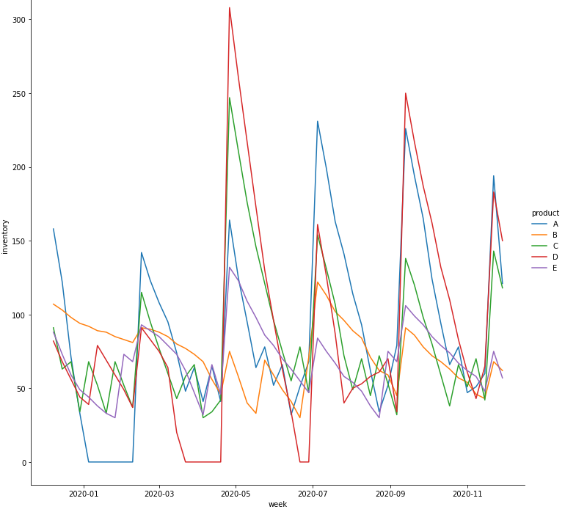
Project analysis slide 10
Inventory Management
The orders condition in weeks of product A, B, C, D, E
Customer's interests (views) in weeks of product A, B, C, D, E
Customer's interests (cart_adds) in weeks of product A, B, C, D, E
Price changes in weeks of product A, B, C, D, E
Inventory conditions in weeks of product A, B, C, D, E

Slide 5
Project analysis slide 8
Inventory Management
Orders forecast model:
Purpose: predict the customer demand at certain time with other marketing data of a product
Data used: time, price, views, cart-adds, product name
Accuracy/error value (MSE): 32.6
How to use: call the model with planned data time, price, views from last week, cart-adds from last week,
product name; outputs the demand of the product.
Inventory optimization model:
Purpose: Compare the current stock and the demands to make sure the stock next week can fulfill customers’ orders
How to use: Use Excel and Solver (one-step solution), or you can calculate the difference between current stock and
demand which equals to the inventory amount.

Slide 6
Project analysis slide 6
Inventory Management
Further improvement
The particularity of products:
The input data does not include what the products are. The relations among products, the departments of them and deeper particularity could be found out if the products are known.
Data limitation:
The input data only covered one year. The seasonality effect of supply-demand will be more obvious if the data covered longer time.
Products:
Consider its lifetime/service time of the product, some products require fulfill or exchange after a period of time, so the orders of these products have more structured patterns.
Price and demand:
Price may impact the demand; some customers changed their mind/made decisions about ordering about prices. Also, the price of same products from competitors will also impact customers’ demand in Bestbuy.
Products:
Bestbuy sells many electronic appliances which may update very quickly, so each product has the risk of being less popular after the new generation comes out

Slide 7
Thank You
Dorothy Zou

